Slide 1
FIVE TRANSLATIONS OF ARISTOTLE’S CATEGORIES, or, HOW TO GET BEYOND THE SILOES OF TRANSLATION STUDIES

Slide 2
Today’s Digital Project Workflow

Slide 3
Types of data, and the work to prepare it
Type | Examples | Import Prep
Transcriptions | Texts | OCR → Unicode Proofread Normalize Segment
Annotations | Sentence ←→ sentence Token ←→ token Morphology (part of speech) Syntax (treebanking) Lexemes Quotations | Interpret, reconcile definitions, taxonomies Convert to your syntax Fill in missing assumptions
Language resources | Lexica Collocations Morphological data / analyzers Semantic groups (WordNet)

Slide 4
Formats we import and export
Format | Unicode | Directly usable | Metadata | Regulated | RDF | Cross-project
Print |  |  | ?
PDF | ✓ |  | ?
HTML | ✓ | ✓ | ? |  | ?
TXT | ✓ | ✓
XML / TEI | ✓ | ✓ | ✓ | ✓* | ?
Databases | ✓ | ? | ? | ✓ | ?
See handout

Slide 5
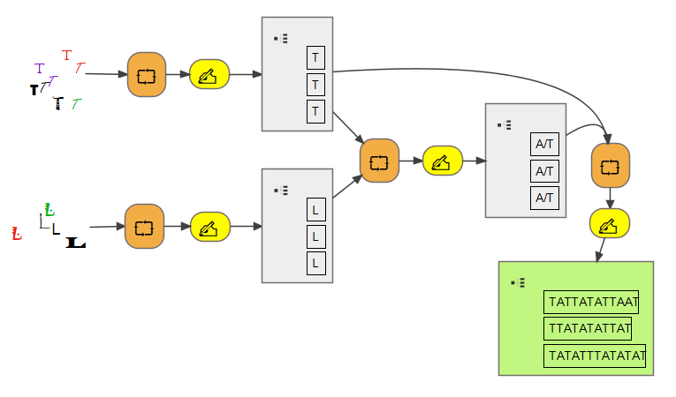
Single Project Workflow

Slide 6
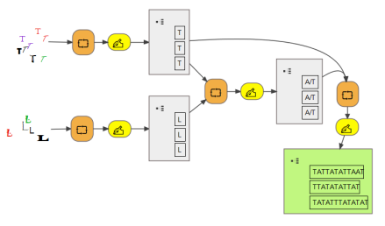
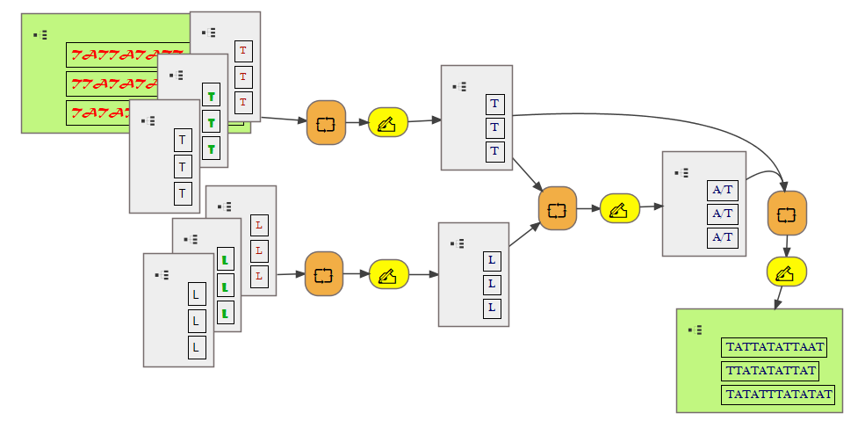
Cross-Project Workflow

Slide 7
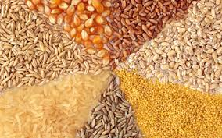
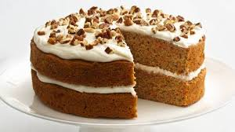
Metaphors
Siloes
Grains
Cakes

Slide 8
Revising the Digital Project Workflow

Slide 9
Hypothesis
Our texts, annotations, and language resources can (and should) be made more interoperable
The formats we currently use are too laissez faire.
We need more rules.
XML is the correct technology.
Efforts so far (e.g., TEI) only begin to tap into the power of XML.

Slide 10
Methodology
Find an important, difficult text with multiple translations.
Assess the corpora that already exist.
Model how independent projects might use a more regulated XML format to build corpora that are interoperable across projects.
Due to time constraints, tests are limited to transcriptions.
Results are comparable for annotations, language resources.

Slide 11
1. Important, difficult text: Aristotle, Categories
Written in ancient Greek
About 10,000 words
Highly influential
Translated in antiquity
                Latin (6x?) • Syriac (3x) • Arabic • Armenian
Many modern translations, editions
2 competing critical editions of the Greek (Minio-Paluello 1949, Bodëús 2004)

Slide 12
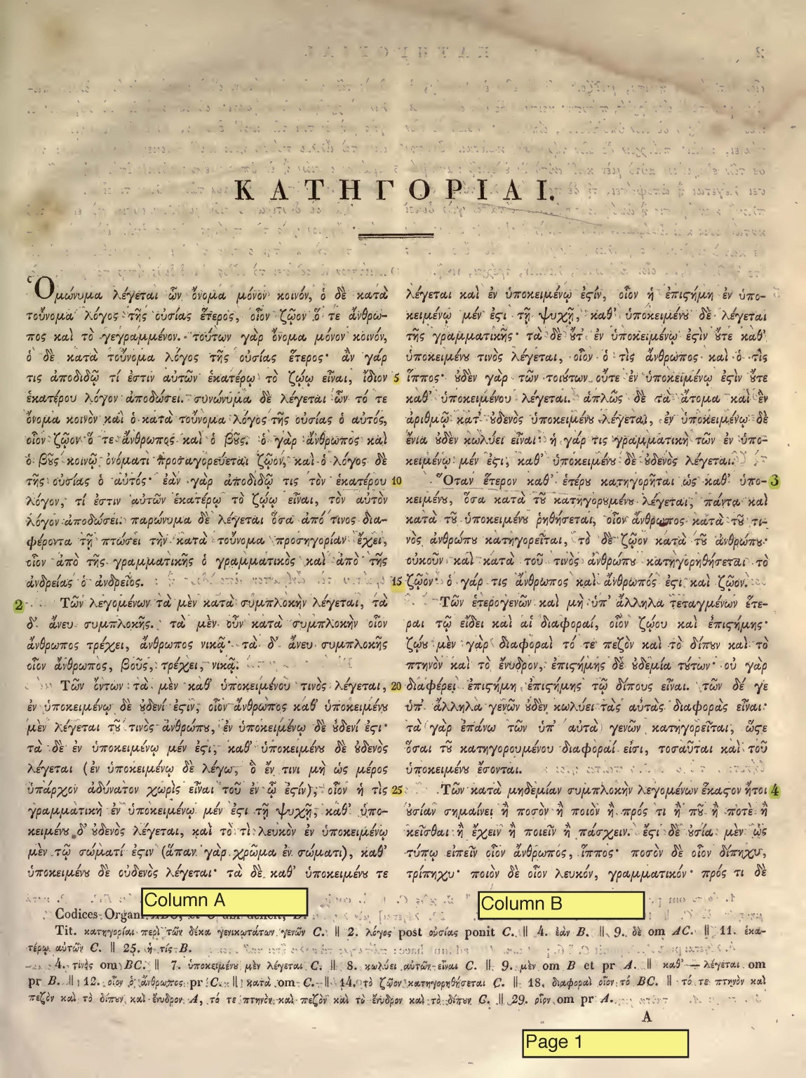
Difficulty 1: Segmentation
Bekker, 1831 edition
Two reference systems: (1) chapters and (2) page, column, and line numbers

Slide 13
Two types of reference systems
Reference Type | Defined by | Examples
Logical | Conceptual units that have meaning independent of any particular manifestation | Chapter Book Paragraph Sentence Clause Line (poetry) Title Rubric
Scriptum-oriented | Material units that have meaning with reference only to a particular manifestation | Volume Page Folio Column Line (physical) Minute-mark
Scriptum: any text-bearing object. Examples: book, magazine, papyrus, billboard, T-shirt, digital file

Slide 14
Difficulty 1a: Logical References
Different ways of dividing the Categories, each intellectually defensible or interesting
Chapters tend to be pretty stable.
Subchapters, paragraphs, sentences, clauses dependent upon the whims of the editor
Benefits: Concordance might be possible. Easier to align translations.
Drawbacks: Not the most popular way to refer to the Categories. Units smaller than chapters not standardized.

Slide 15
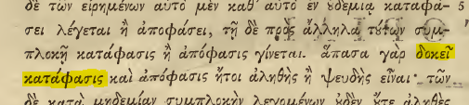

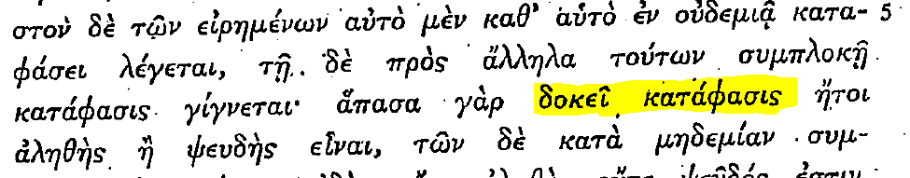
Difficulty 1b: Scriptum-based references
Bekker 1831
Bekker 1837
Minio-Paluello 1949
Ar. Cat. 2a7–8
(= Bekker 1831 page 2, column 1, lines 7-8)
Benefits: popular way to refer to the text. Affords precision.
Drawbacks: Discordance guaranteed. Hard for aligning translations.

Slide 16
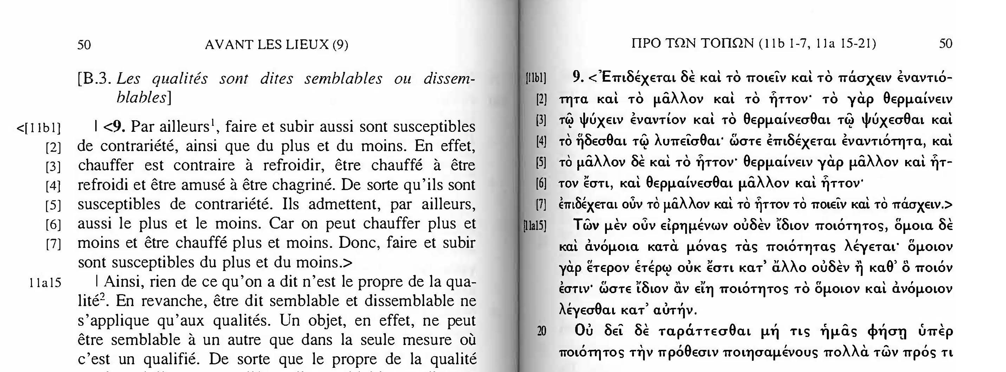
Secondary difficulty: Text order of the Categories
Bodëús 2004
11b1-7 moved to between 11a14 and 11a15

Slide 17
2. Assess what exists
                Many endeavors to encode the Categories
                Most versions and translations available in non-optimal formats: print, Classical Text Editor, Word, PDF, plain text.
                Some use better formats…
Follow along at http://textalign.net/doha

Slide 18
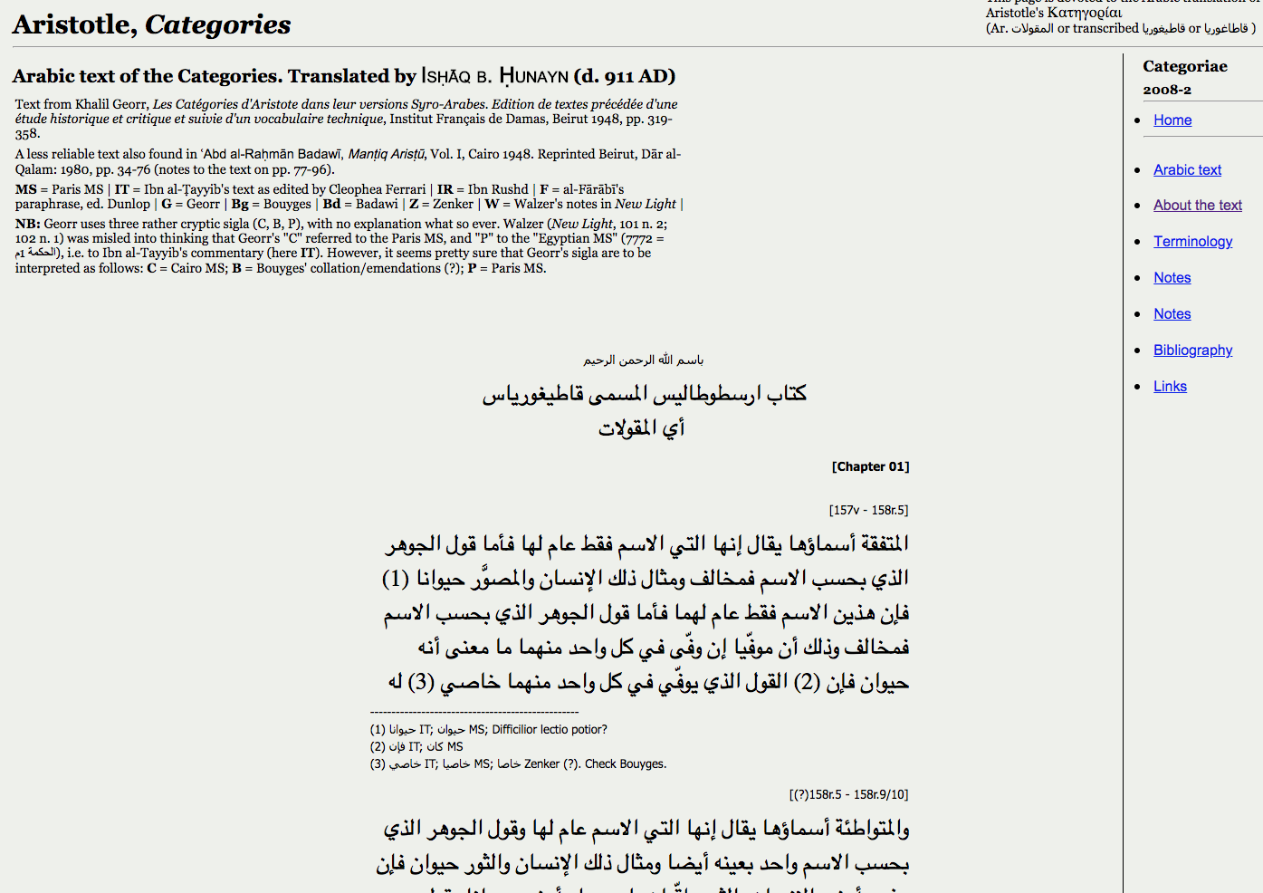
Oslo Arabic Seminar
Arabic
PHP / HTML only
Presentation format (cake)

Slide 19
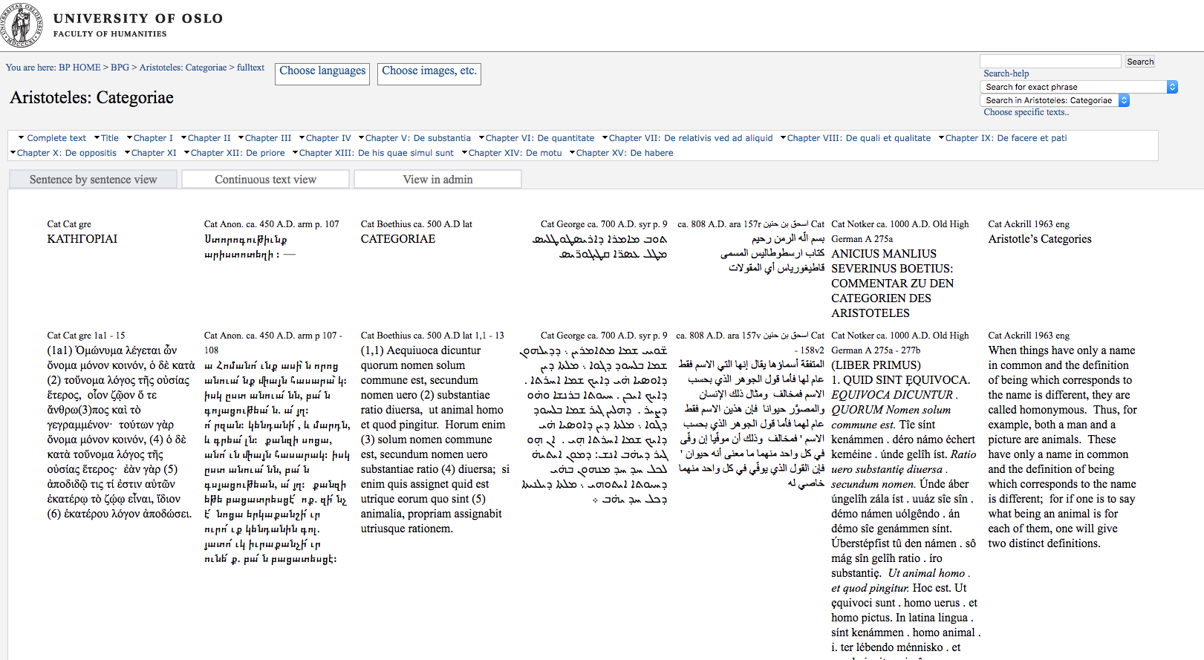
Bibliotheca Polyglotta
Greek, Armenian, Latin, Syriac, Arabic, Old High German, English
HTML only
Presentation format (cake)

Slide 20
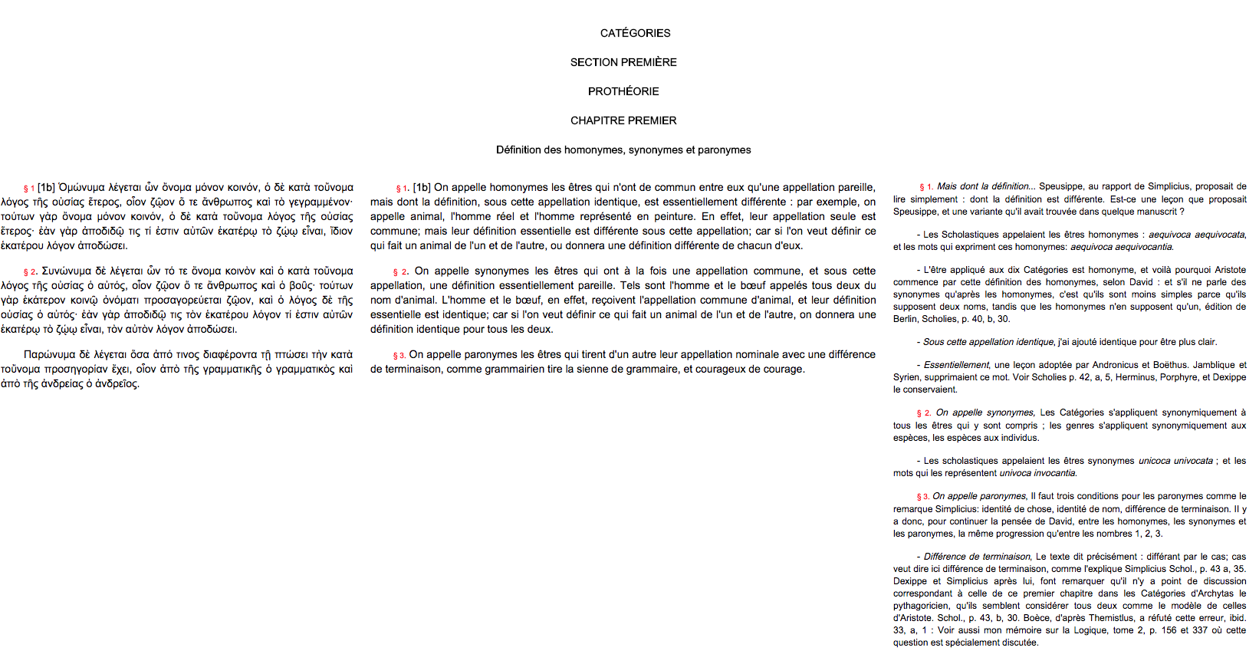
Remacle.org
Greek, French
HTML only
Presentation format (cake)

Slide 21
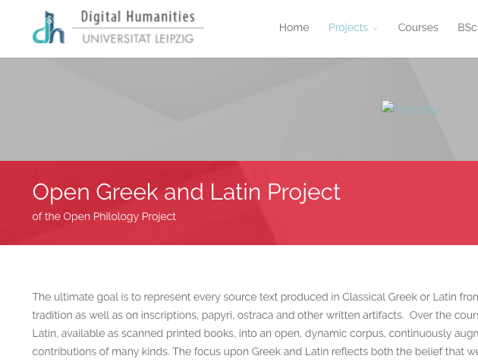
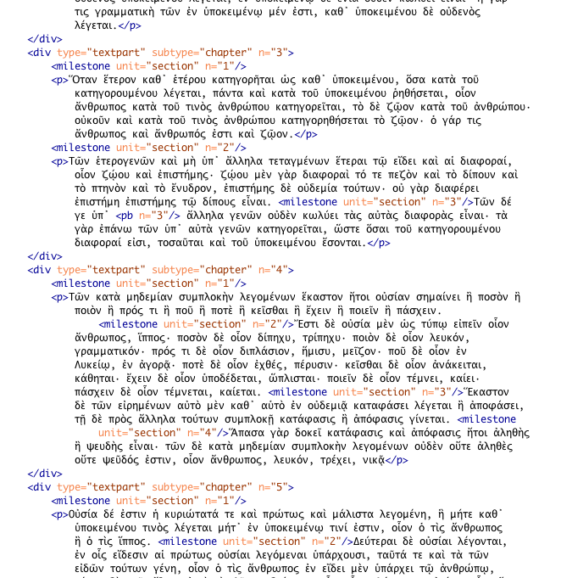
Open Greek and Latin
Greek only
TEI XML
Master file

Slide 22
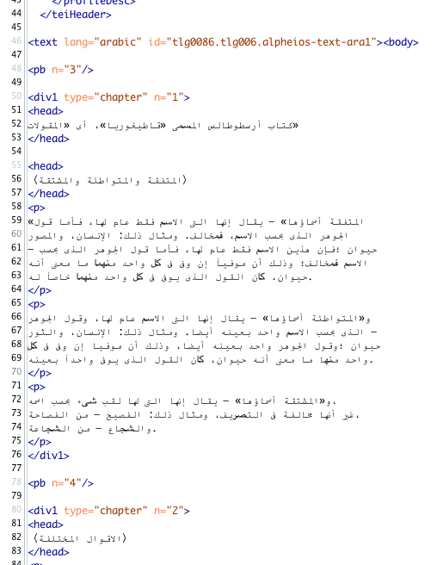
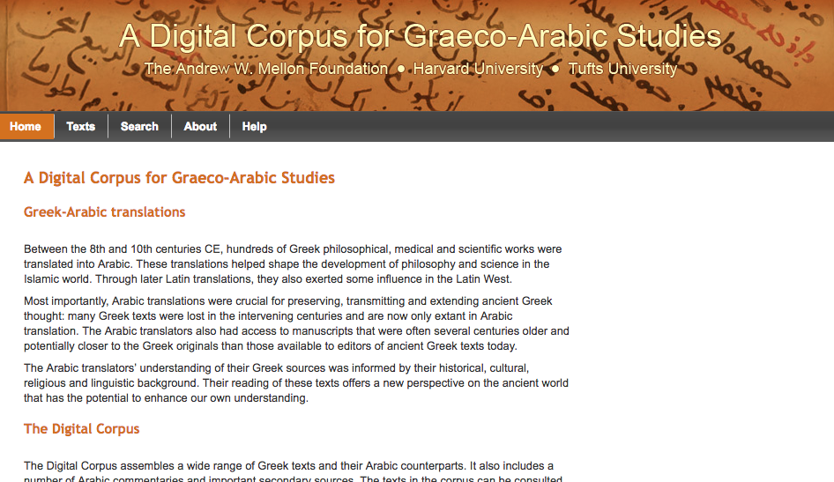
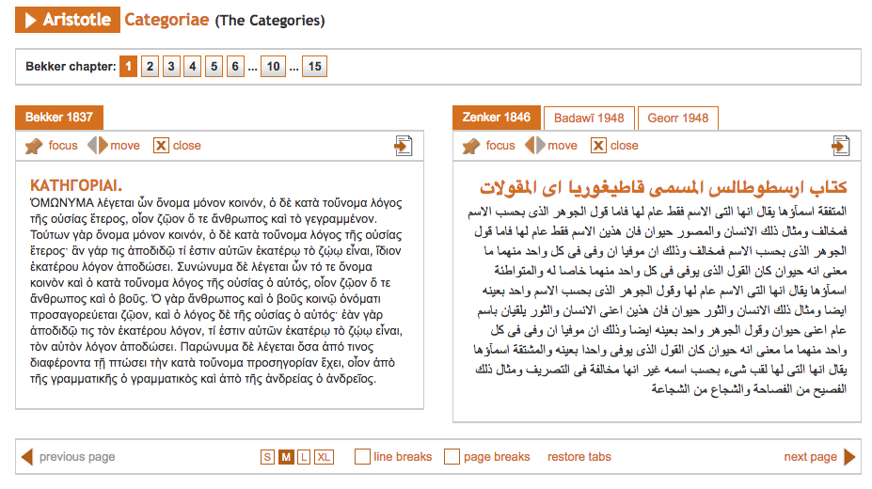
Digital Corpus of Graeco-Arabic Studies
Greek, Arabic
HTML, TEI XML
Presentation + master file

Slide 23
3. Model a cross-project, heavily regulated XML format
Set up two independent Aristotle projects
Use TAN XML
See what happens

Slide 24
Text Alignment Network
A suite of highly regulated XML formats for the interoperable alignment and exchange of texts, annotations, and language resources across projects.
Human readable
Semantic-centric (RDF-friendly)
Scholarly orientation
An Internet for primary sources and commentary
http://textalign.net/

Slide 25
The TAN method
Each transcription file is devoted exclusively to one version of one work from one scriptum segmented according to one reference system.
If you want another version or reference system, make a new file. (TAN validation checks and helps fix differences.)
Point to your models.
Keep annotations outside the transcriptions.

Slide 26
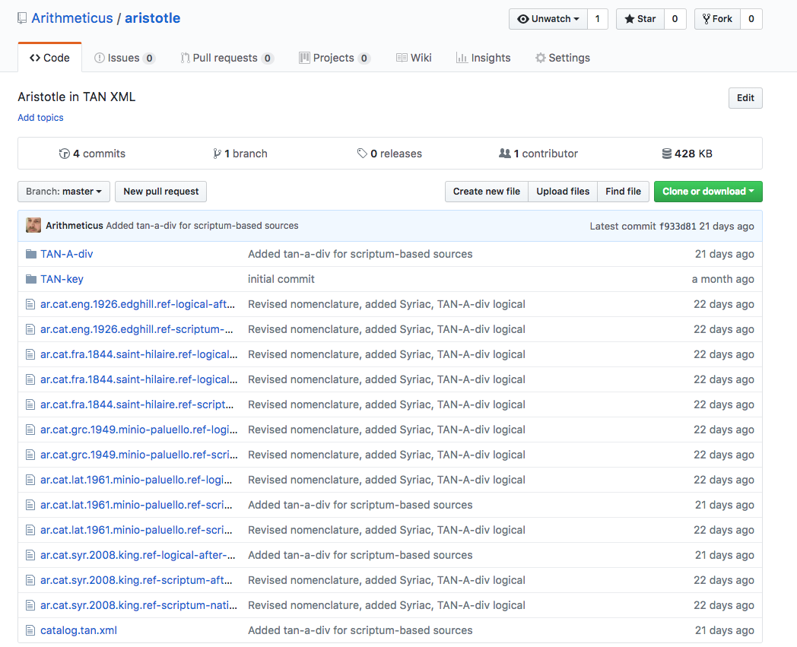
TAN project 1
https://github.com/Arithmeticus/aristotle
Greek, Latin, Syriac, English, French
Both Bekker line numbers and logical references
Lots of OCR and conversion from PDF, DOCX, CTE, HTML (unbaking cakes)

Slide 27
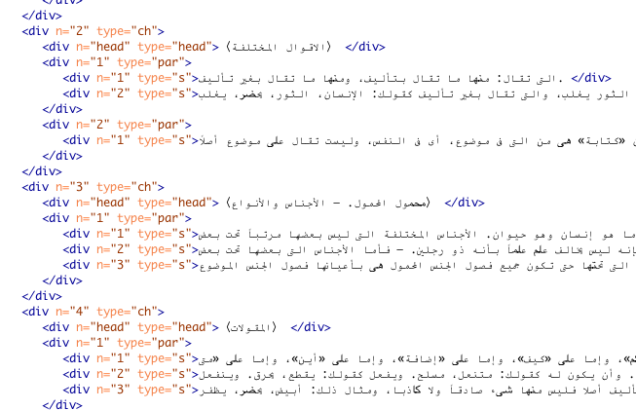
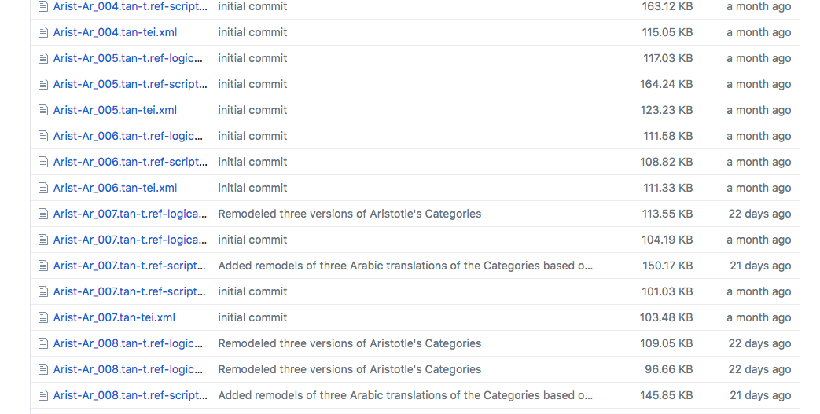
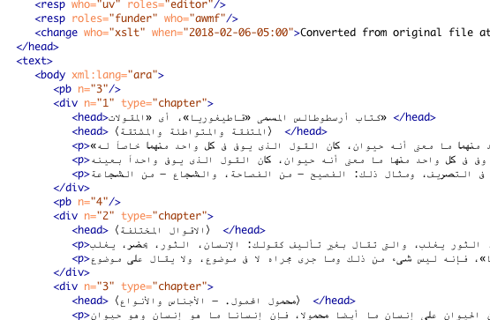
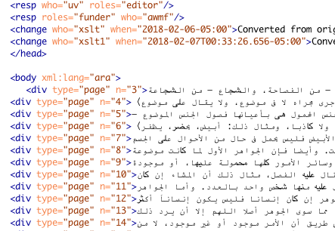
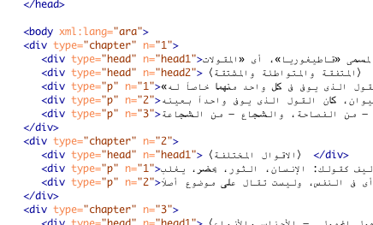
TAN project 2
https://github.com/Arithmeticus/graeco-arabic
Digital Corpus for Graeco-Arabic Studies.
Greek, Arabic, converted to both Bekker and chapter reference systems
Conversion from TEI version 2 to TAN-TEI (sorting out grains)

Slide 28
Results

Slide 29
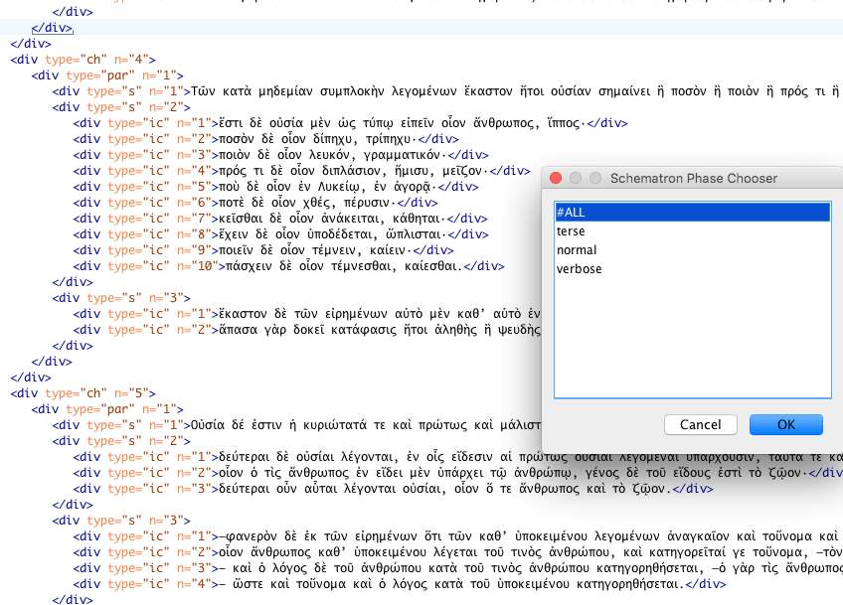
Result 1: Different levels of feedback
Validation (based on RELAX-NG, Schematron) applicable no matter the project
Dozens of types of errors checked

Slide 30
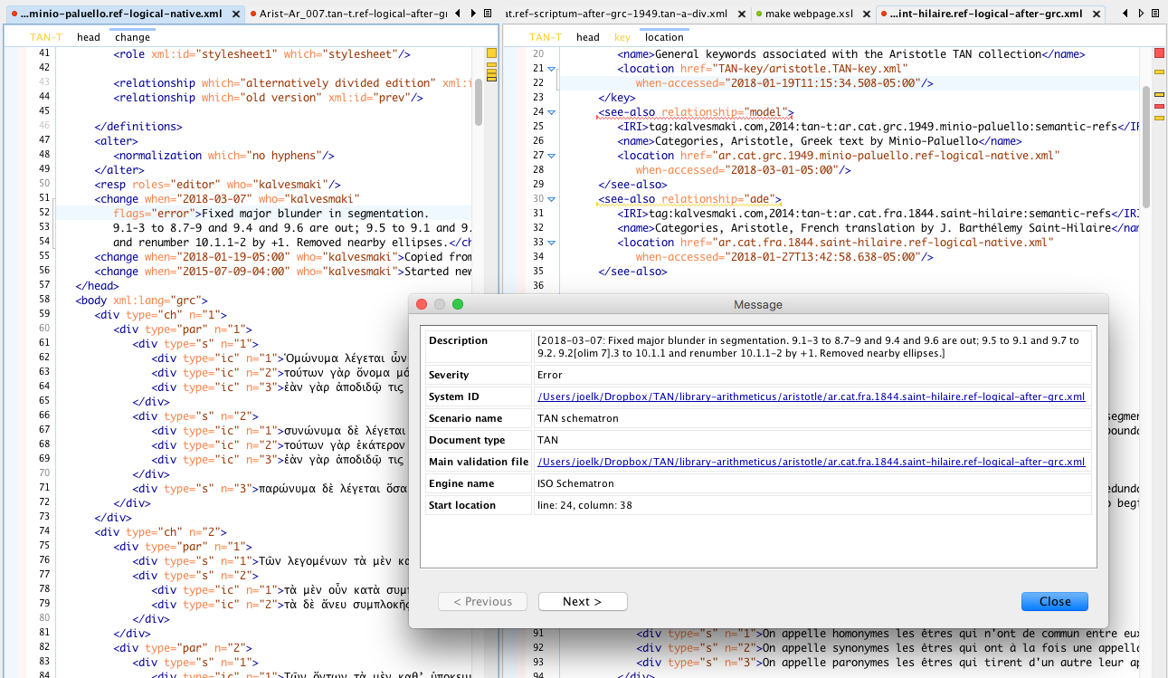
Result 2: Cross-project communication
Project 1 (left) corrects source transcription.
When independent Project 2 (right) validates its file it is told about the problem in the dependency.

Slide 31
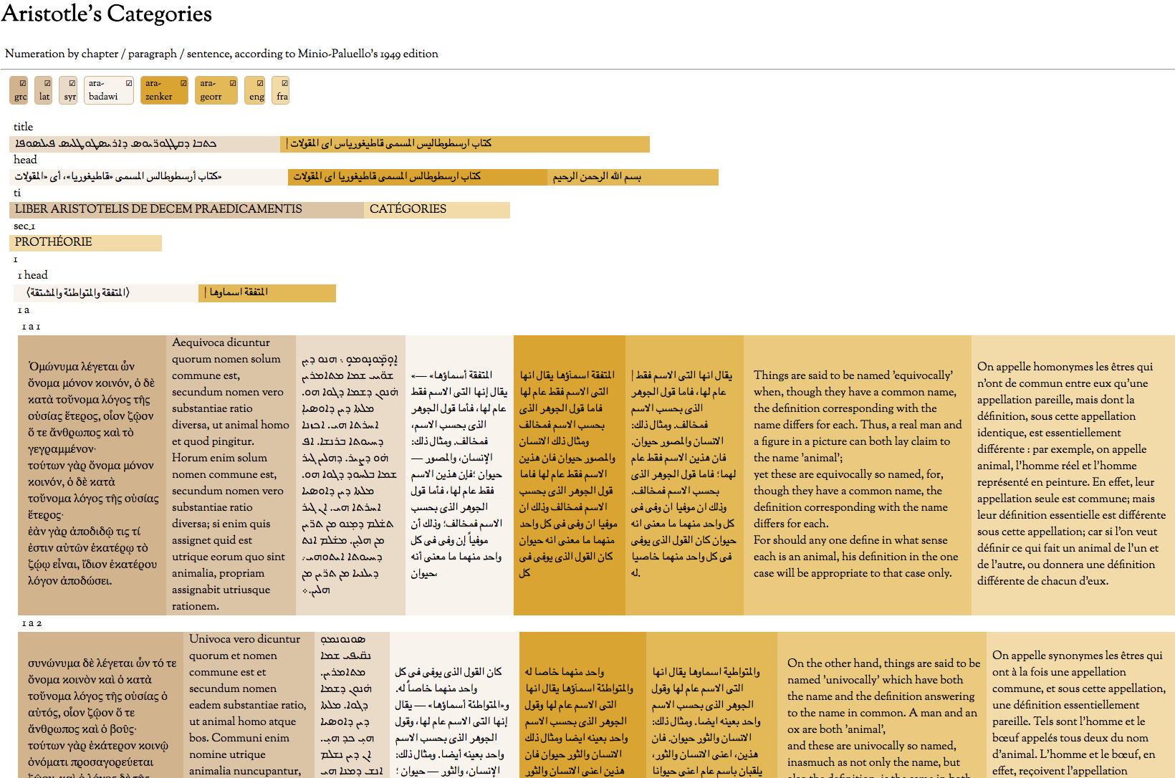
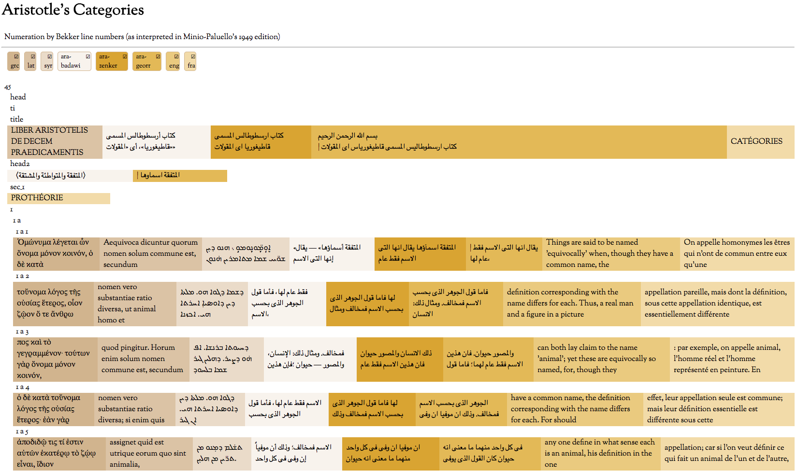
Result 3: Collation
Party 3 finds both corpora, and puts them through a TAN stylesheet for displaying parallel versions.
Useful for reading, research, language learning

Slide 32
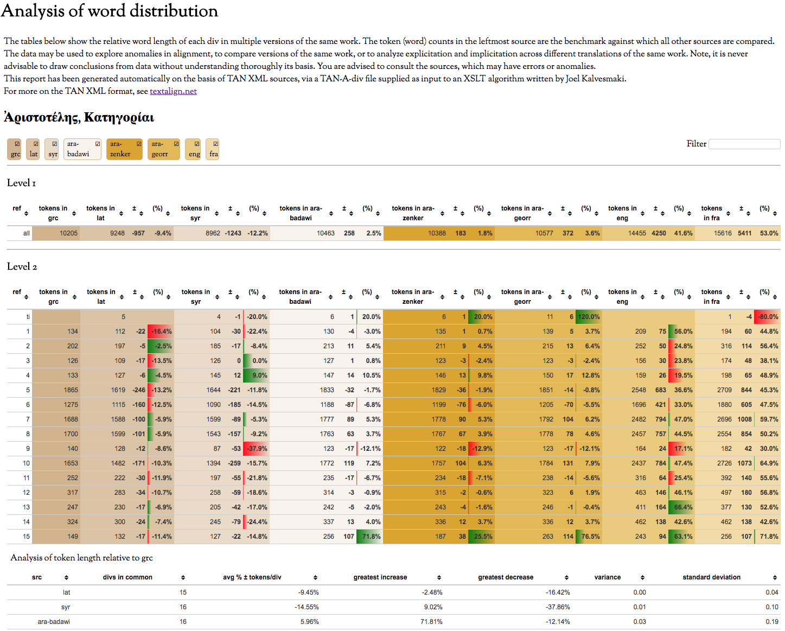
Result 4: Analysis
Party 3 finds both corpora, and puts them through a TAN stylesheet to compare word distribution.
Useful for finding errors, anomalies, translator idiosyncrasies; comparing translations across languages; measuring and testing explicitation/ implicitation

Slide 33
TAN formats not discussed
Annotations
TAN-A-tok: word-for-word bitext alignments
TAN-A-div: annotations across multiple versions of multiple works (quotations, topics, etc.)
TAN-A-lm: lexico-morphological data for one text
Language resources
TAN-A-lm (lang): lexico-morphological data independent of any text
TAN-mor: part-of-speech codes, rules, semantics

Slide 34
Other TAN benefits
Interoperability enhanced
Editing tools
Extensive library of functions
Useful algorithms can be written (current or planned: IBM models 1 & 2, quotation detection, morphological analysis)
A tool made for one TAN file is a tool made for all
Texts, annotations can be discovered (a kind of Napster for primary sources)

Slide 35
TAN status
Version 2018 available
Future releases under development
Extensive documentation
Successful in four different projects so far
ISO projects or departments already funded interested in trying it
http://textalign.net/

Slide 36
Conclusion
We can make our data more interoperable
To do so, we need more regulated XML
Our master files should be simple, dedicated files (grains)
Our siloes (digital corpora) should be populated with grains (not cakes), separated and predictably organized.

Slide 37
Thank you
Joel Kalvesmaki
Dumbarton Oaks
kalvesmaki@gmail.com

